Slide 1
B2B KT Session 2
Ticketing & Incident Management Process, SLAs, Escalation Matrix

Slide 2
Overview
Ticketing & Incident Management Process
OneInc Vendor Ticket Creation Process
OneInc Escalation Procedures
Technical Emergency Escalation
Incident Flow Diagram
OneInc Account Team Contact Information
SLAs
Escalation Matrix

Slide 3
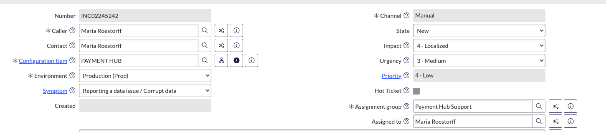
Ticketing & Incident Management Process
Service Desk – Support Tickets
Service Now – Incidents for Break Glass

Slide 4
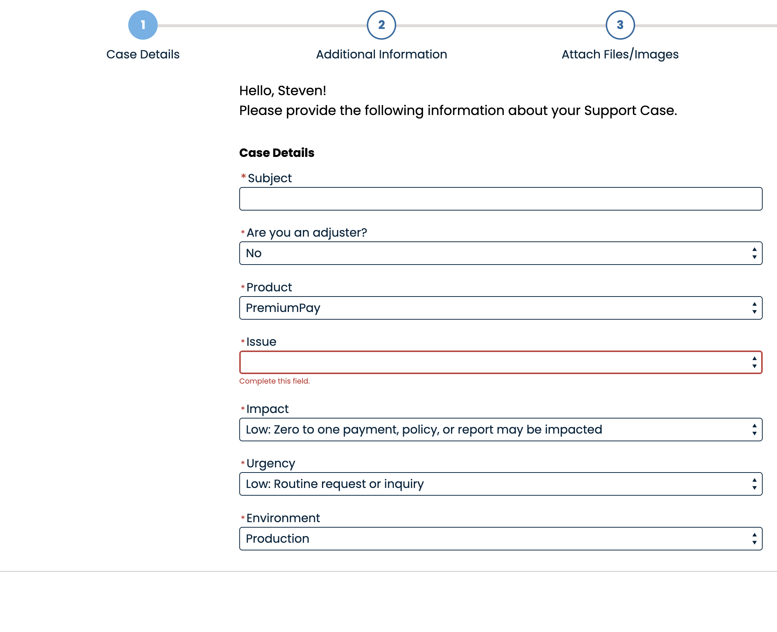
OneInc Vendor Ticket Creation Process
OneInc Support Portal: https://connectone.oneinc.com/s/login?ec=302&startURL=%2Fs%2Fsupport
Support Tickets can be created in OneInc’s portal via the link above

Slide 5
OneInc Escalation Procedures
Creating a Blocker Cases will trigger immediate alerts and notify requesters about the after-hours emergency line (888-774-8020). To do this you need to select Impact High & Urgency High
**certain users will have this mid-level access to create High Urgency & High Impact cases, we should have representation from Payment Hub, Navigator & Treasury.
In the event a P1 Incident is triggered , we should follow the first step and open a high impact high urgency case with OneInc, but we also need to
Open a P1 Service Now Ticket with LM , notify the Navigator Team (Navigator's Service Now Group: CLAIMS FINANCIAL) and trigger a Bridge Call
Send a communication to all LM Senior leaders to keep them informed…. (Payment Hub, Navigator, the Claims Teams & Treasury)
Update the Treasury System Status page that will trigger an email update to our Claims Partners and anyone who has subscribed to that page. Treasury Systems - Status Page
In the event that we cant contact OneInc via this emergency number that we have the option to reach out to the account team: 1-888-774-8020

Slide 6
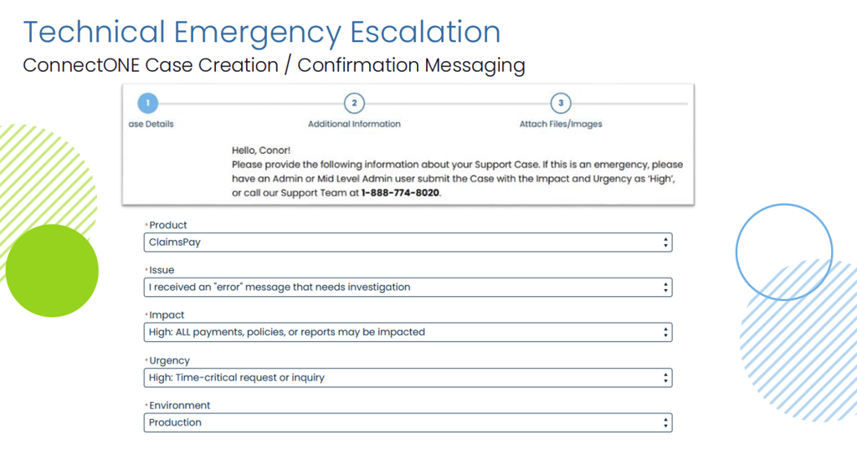
Technical Emergency Escalation

Slide 7
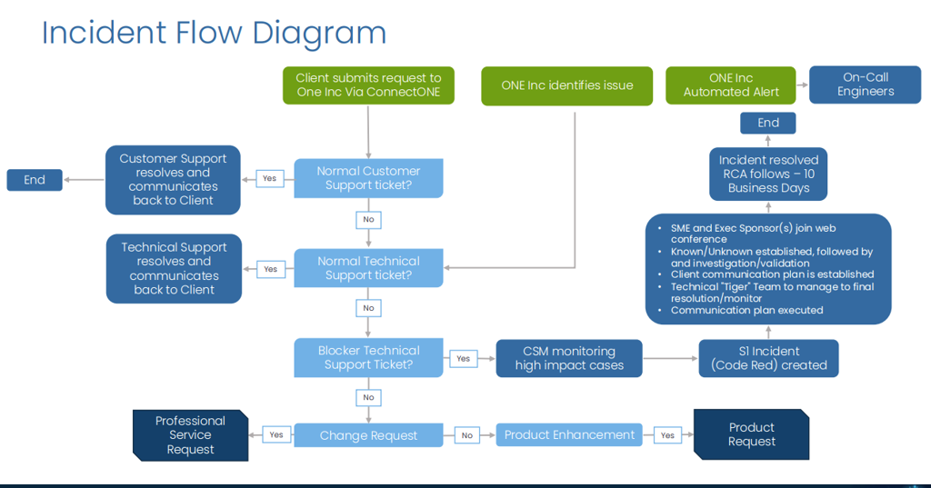
Incident Flow Diagram

Slide 8
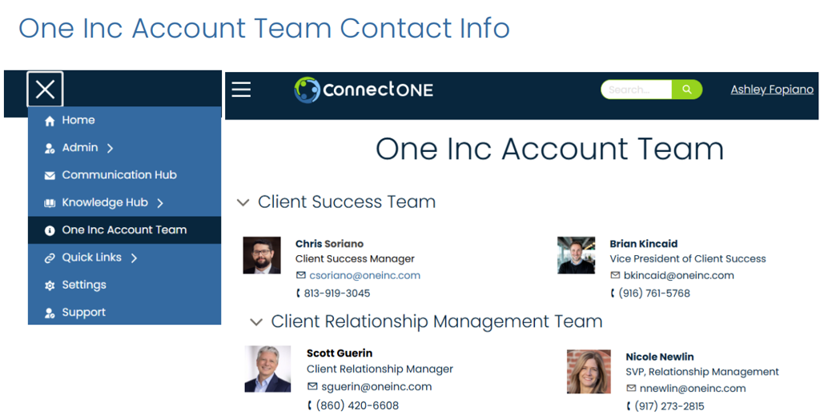
OneInc Account Team Contact Information

Slide 9
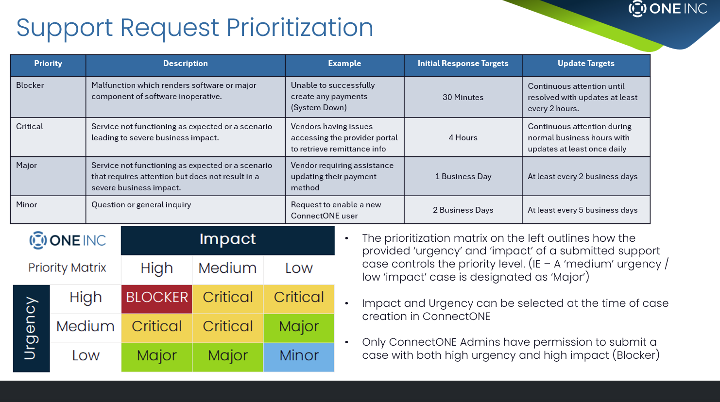
SLAs
More information about production support at https://libertymutual.atlassian.net/wiki/spaces/CPH/pages/1581526829/B2B+Channel+OneInc+Production+Support

Slide 10
Escalation Matrix
Impact
High: Many payments/reports affected; major outage halts operations. (e.g., high value/volume failures)
Medium: Some payments/reports affected; partial/localized issue. (e.g., lower volume failures, webhooks failing)
Low: 0–1 payment/report affected; isolated issue/request. (e.g., single payment, general inquiries/feature requests)
Urgency
High: Time-critical; many payments failing or platform inaccessible – immediate action required. (e.g., no payments processing, NACHA discrepancies, can’t access platform)
Medium: Time-sensitive; a handful of payments impacted – address promptly. (e.g., fraud review, payment feedback discrepancies)
Low: Routine request; handled in normal business flow. (e.g., payment status inquiry, EOB issue, general support)

